Slide 1
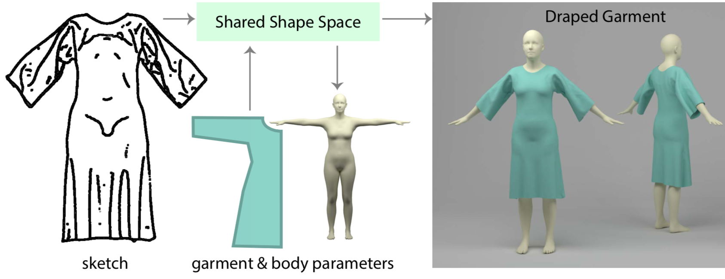
Learning a Shared Shape Space for Multimodal Garment Design
Presenter: Yuan Yao
Oct 15th, 2018

Slide 2
Outline
Related Works
Contribution
Conclusion
Discussion

Slide 3
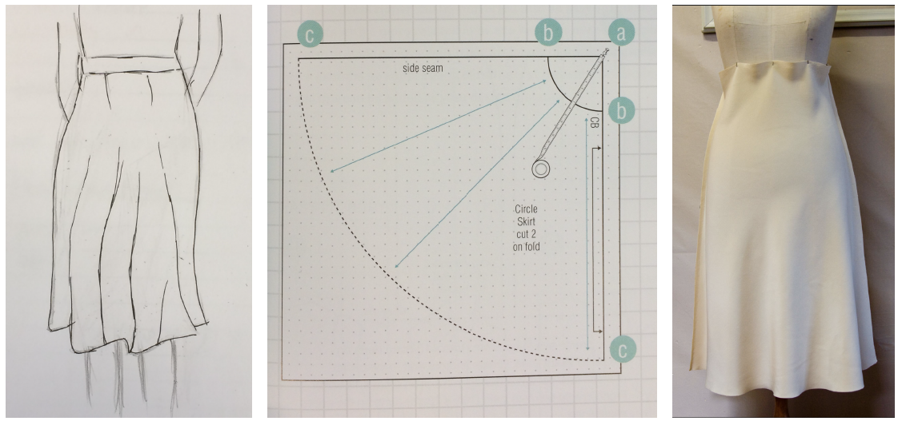
Related Works
Traditional garment design is a complex process
Notes:
Traditional garment design is a complex process. Starting with initial 2D sketches of the desired garment, the designer creates the necessary flat sewing patterns which are then stitched together into a garment.

Slide 4
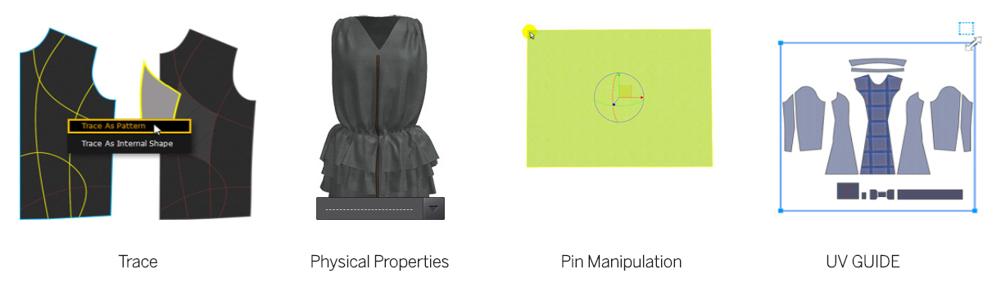
Related Works
Marvelous Designer[mar 2018]
Notes:
To help with the designer, there are some existing physical draping or physics-draped simulation methods which are formed into professional
tools in industry.

Slide 5
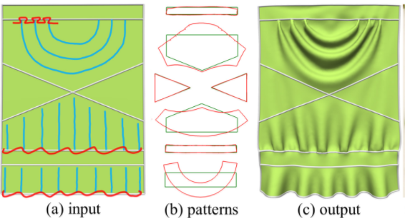
Related Works
FoldSketch[Li et al. 2018]
Notes:
The research community also tried a lot to propose alternative computational tools. For example, this work focuses on automatically parsing 2D garment patterns to 3D, this work allow user to draw strokes on the 3d draped garment to denote different types of folds. This work directly infer 3d shapes from 3d sketches.

Slide 6
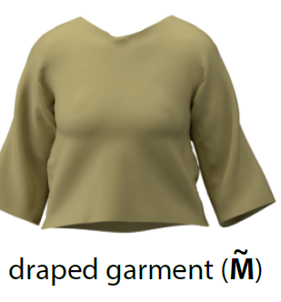
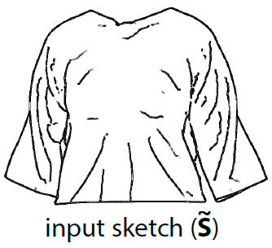
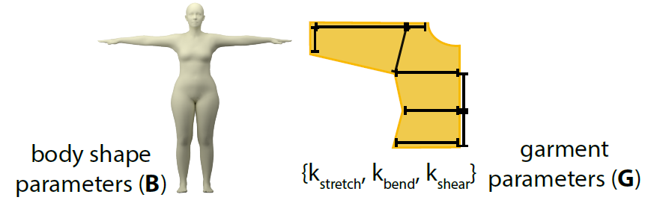
Contribution - observation
Three modalities in the garment design workflow.
Notes:
What does this paper do, let’s start with the workflow of garment design. There are 3 kinds of modalities, sketch

Slide 7
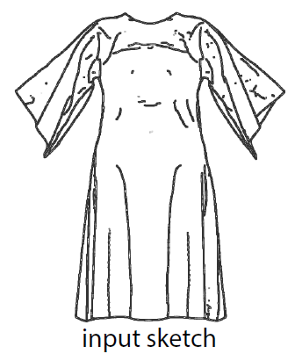
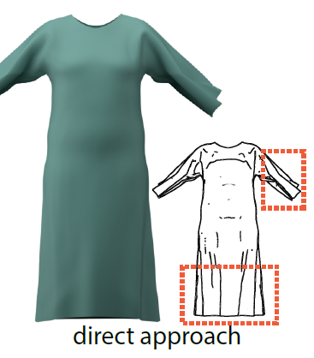
Contribution - observation
Overfit when directly training between two domains.
Notes:
What if we directly training from one domain to another domain, it will overfit like this.

Slide 8
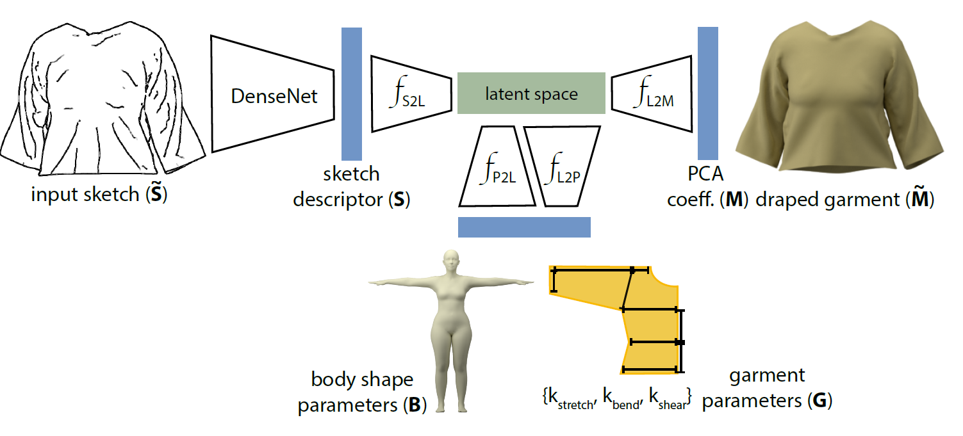
Contribution – Shared Shape Space
The shared latent space regularizes the learning problem by linking the different domains.
Notes:
So they propose a shared shape space or latent space to link all the 3 domains. And training 4 networks between the latent space and domains.

Slide 9
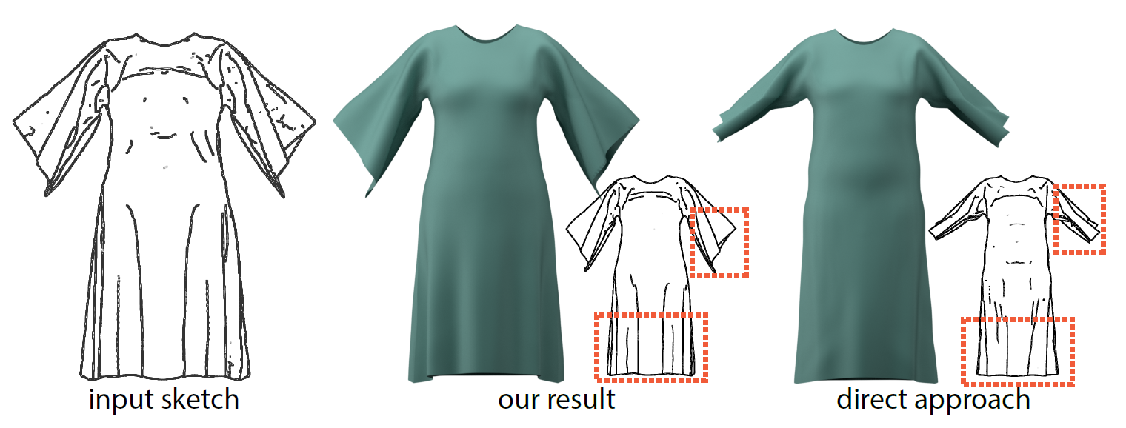
Contribution – Shared Shape Space
Notes:
Using this method, they can produce much better and realistic results.

Slide 10
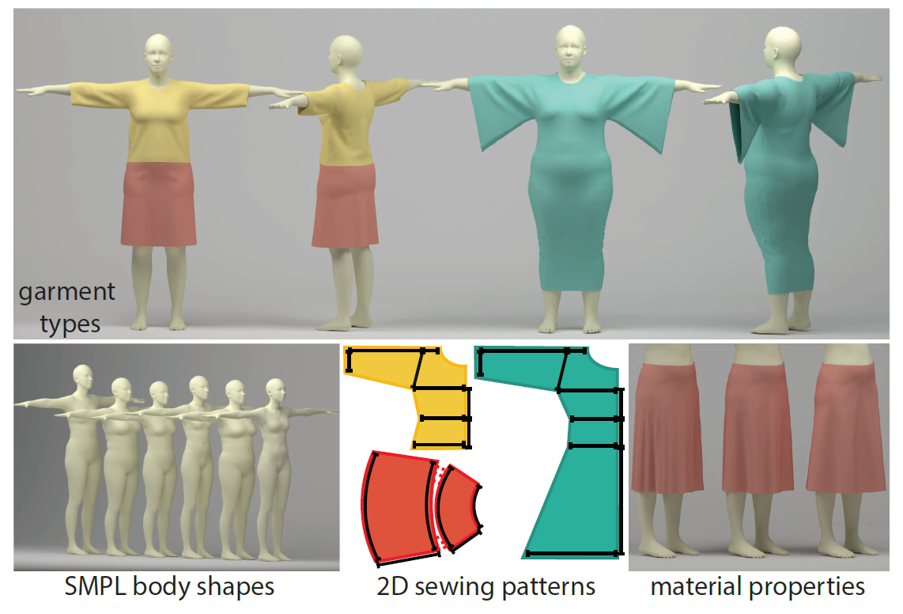
Contribution – Dataset
Notes:
Their dataset consist of the body shape parameters, sewing patterns, different material and draped garments from sampled parameters.

Slide 11
Contribution – Garment Retargeting
Problem definition: given a garment G designed for a particular body shape B, identify a new set of garment parameters G’ for a new body shape B’ such that the look and feel of the draped garments on both body shape are similar.
Notes:
One another task they do is garment retargeting. The definition is …

Slide 12
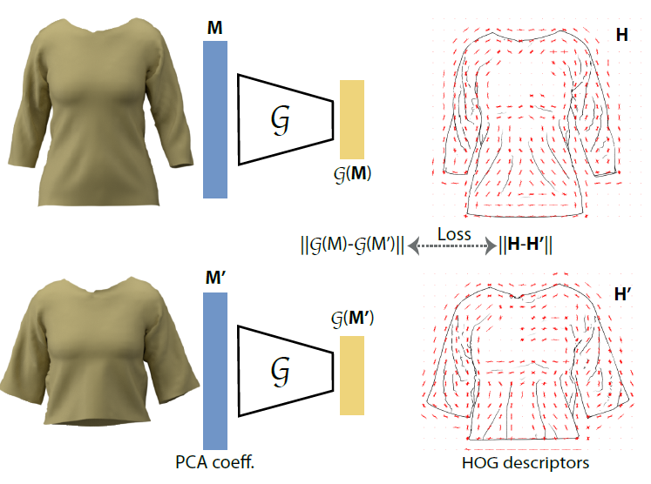
Contribution – Garment Retargeting
Notes:
They train a Siamese network to learn an embedding of draped garment shape, which make the distance between a pair of draped garments in this learned embedding space is similar to the distance between the HOG features of the corresponding sketches. Using this embedding, the problem can be simply formulated as this,

Slide 13
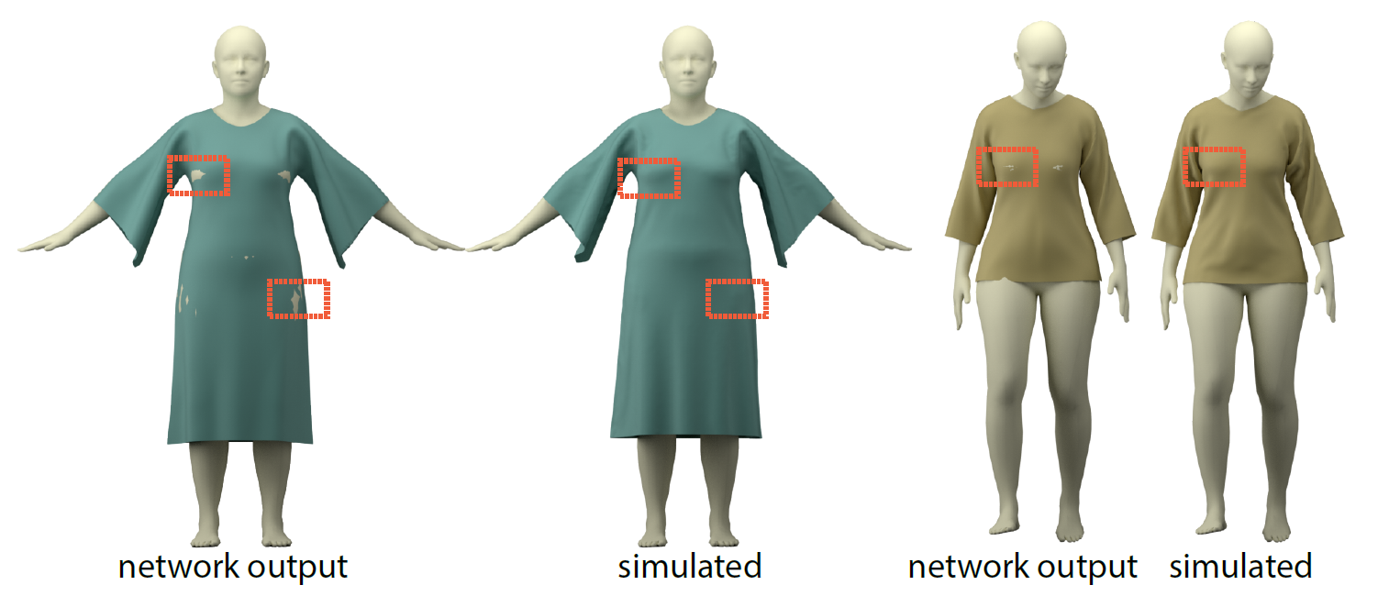
Conclusion & Results
Notes:
These are the results for the method, they closely resemble the simulation results.

Slide 14
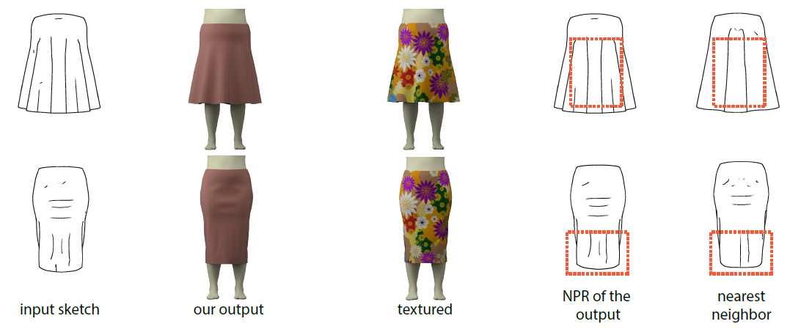
Conclusion & Results
Notes:
These show that their results can capture the folds plausibly, these are the nearest neighbor sketch retrieved from their database.

Slide 15
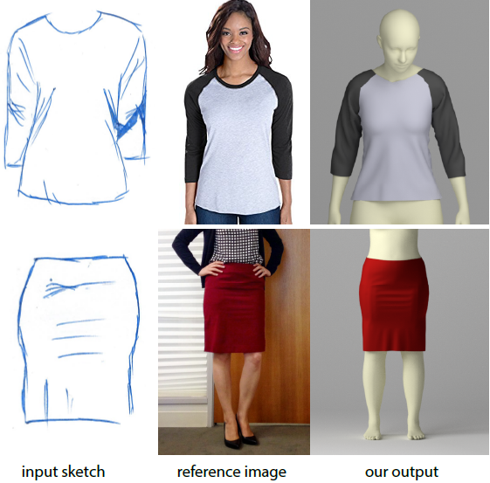
Conclusion & Results
Notes:
They also test on images by letting users to draw the corresponding sketch and feed it into their system.

Slide 16
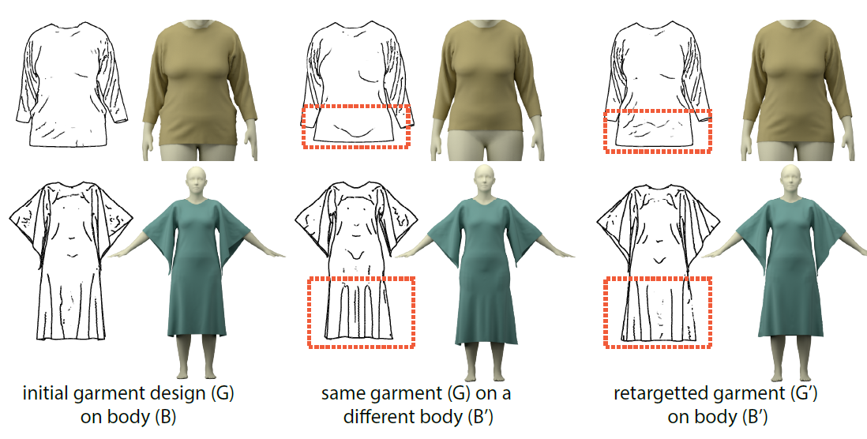
Conclusion & Results
Notes:
These are the results of garment retargeting.

Slide 17
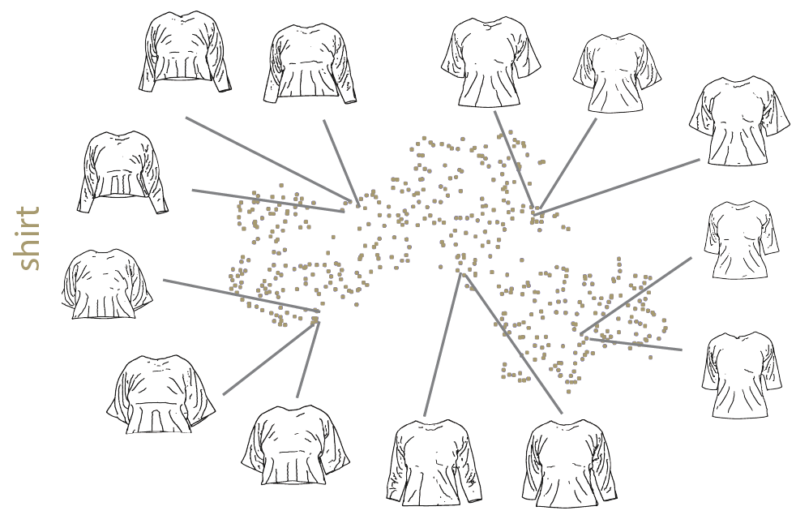
Conclusion & Results
The distance embedding they learn clusters similar garment.
Notes:
Here are the results of embedding, so the similar garment sketch are also similar in the embedding space which would be very helpful for retargetting.

Slide 18
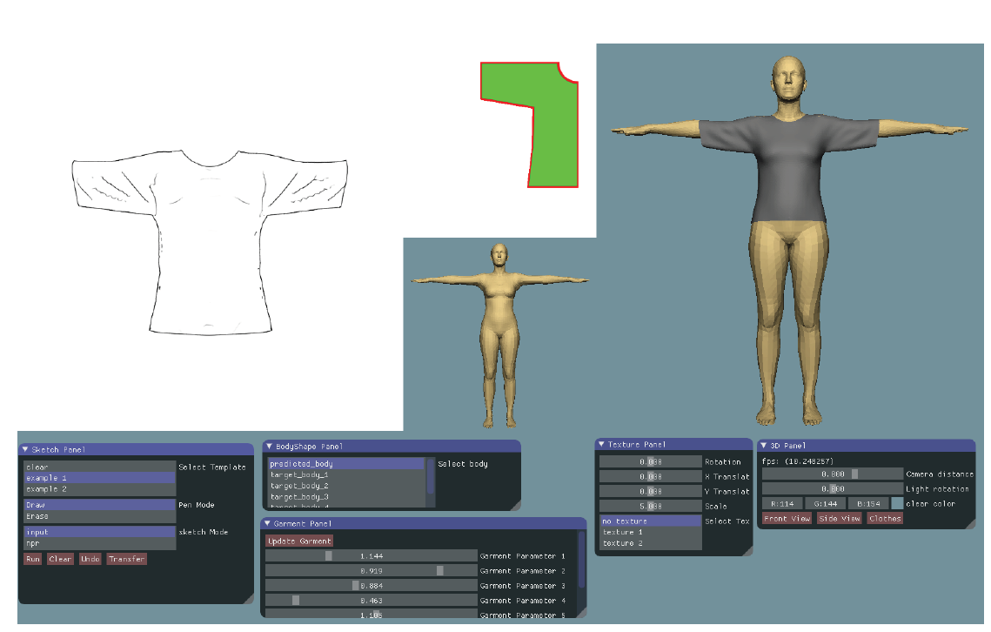
Conclusion & Results
Notes:
They also developed a user interface which allow the user to edit and visualize

Slide 19
Conclusion & Results
Limitation:
Pose variation
Simulator
Pre-defined 2d sewing parameters for each garment type

Slide 20
Discussion

Slide 21
Thank you!

